Slide 1


BLOCKCHAIN Seminar
Let start

Slide 2
Table of contents
01
02
03
04
05
06
How Does Blockchain Work?
Benefits of Blockchain
What is Blockchain?
Applications of Blockchain
Challenges of Blockchain
Challenges of Blockchain

Slide 3
What is Blockchain
01
BLOCK
CHAIN

Slide 4

Whoa!
BLOCK ????? CHAIN?????
Bitcoin????

Slide 5
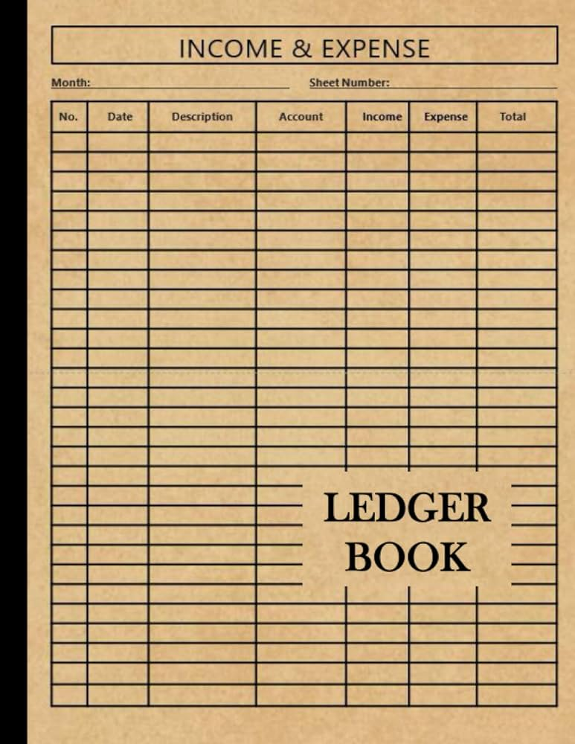


Introduction
A distributed ledger technology
Securely stores digital records
Transparent and tamper-proof
Decentralized network (no single authority)
Notes:
Blockchain is a distributed ledger technology that allows for secure, transparent, and tamper-proof recording of data. Imagine a shared record-keeping system where transactions are replicated and distributed across a network of computers. This eliminates the need for a central authority, fostering trust and security.

Slide 6
How Does Blockchain Work?
Transactions are bundled into blocks
Blocks are cryptographically linked (chained)
Miners validate and add blocks to the chain
Consensus mechanism ensures network agreement
Notes:
Blockchain works by grouping transactions into blocks. These blocks contain data, timestamps, and cryptographic hashes that link them together chronologically, forming a chain. Miners, using powerful computers, solve complex puzzles to validate transactions and add new blocks to the chain. A consensus mechanism, like Proof of Work, ensures all participants in the network agree on the validity of the blockchain.

Slide 7
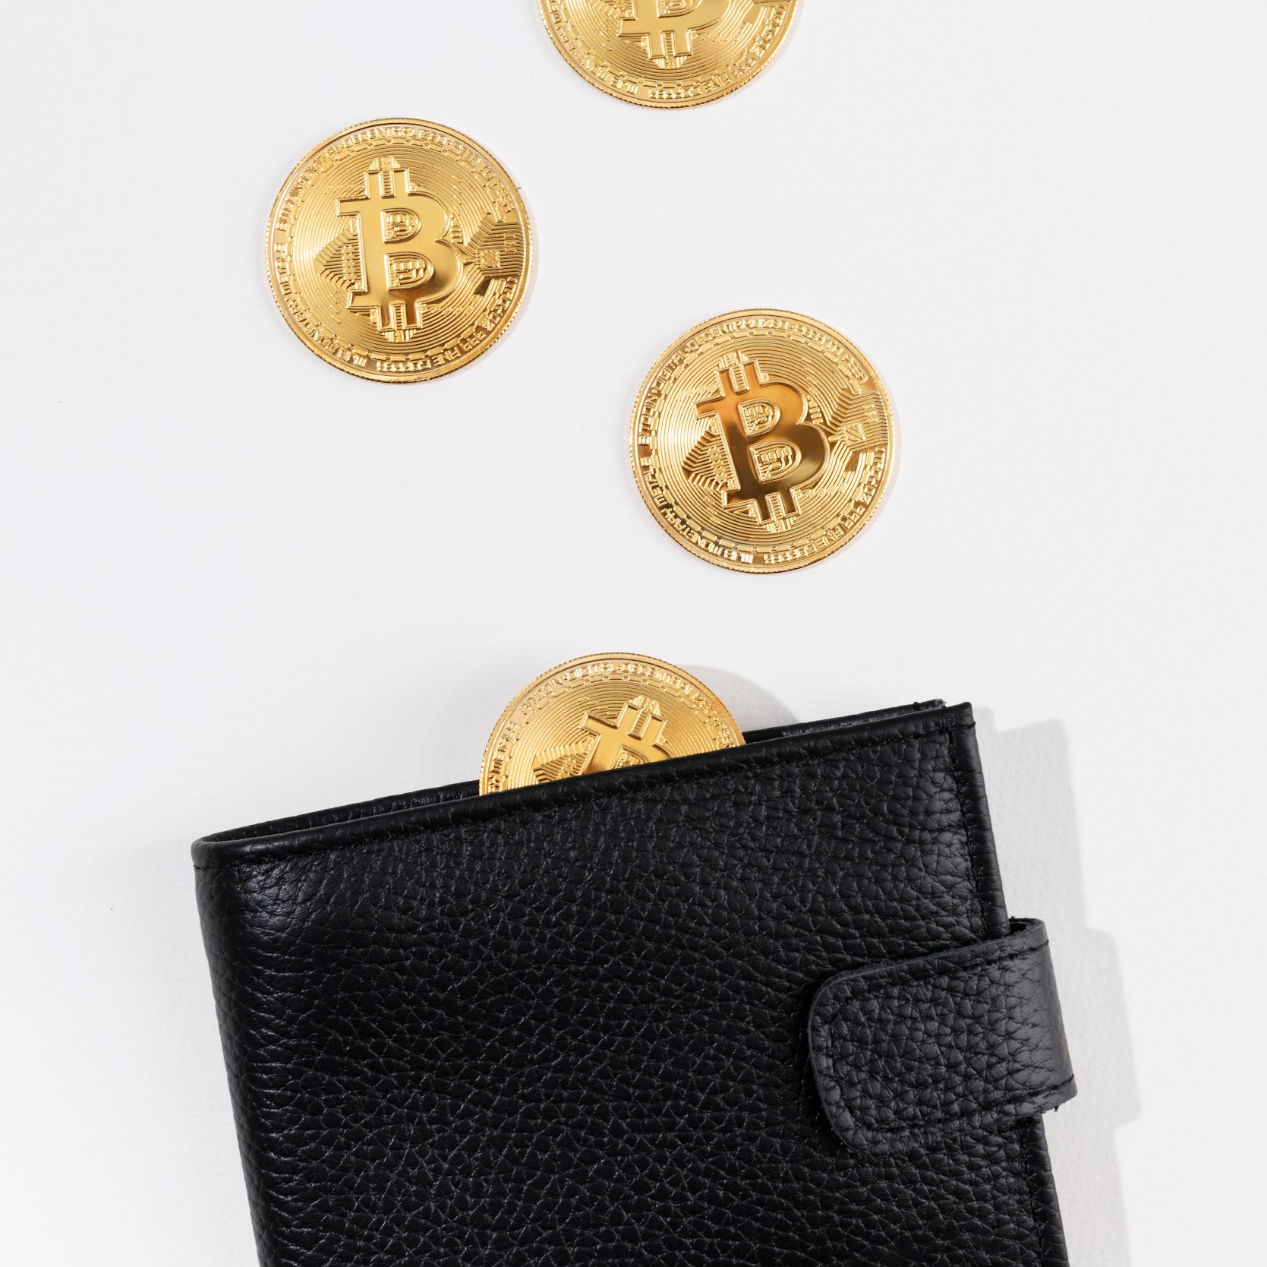
Benefits of Blockchain
Enhanced security: Tamper-proof data
Transparency: All participants have access
Decentralization: No central point of failure
Efficiency: Streamlined processes
Trustless environment: Eliminates intermediaries
Notes:
Blockchain offers several advantages. It provides enhanced security as data on the chain is immutable and verifiable. Its transparency allows all participants to view and track transactions. Decentralization removes the need for a central authority, building trust and reducing costs. Blockchain can streamline processes by automating tasks and eliminating intermediaries.

Slide 8
Applications of Blockchain
Supply Chain Management
Voting Systems
Financial Services
Secure and transparent voting process
Secure and efficient transactions (cryptocurrencies)
Tracking goods from origin to destination

Slide 9
Applications of Blockchain
Healthcare
Identity Management
Secure medical records management
Decentralized and tamper-proof identities
Notes:
The applications of Blockchain are vast and constantly evolving. In finance, it facilitates secure and efficient transactions through cryptocurrencies like Bitcoin. Supply chain management benefits from real-time tracking of goods, ensuring transparency and efficiency. Blockchain can revolutionize voting systems by ensuring secure and transparent elections. Healthcare can leverage blockchain for secure medical record keeping with patient control. Additionally, it can enable decentralized and tamper-proof identity management.

Slide 10

Challenges of Blockchain

Slide 11


Challenges of Blockchain
Scalability
Handling a large volume of transactions
Notes:
High-volume transactions refer to a large number of business processes or transactions that occur within a short period. Sensitive cases also include businesses that have to deal with a continuous flow of voluminous transactions that they deal with on a regular basis.

Slide 12
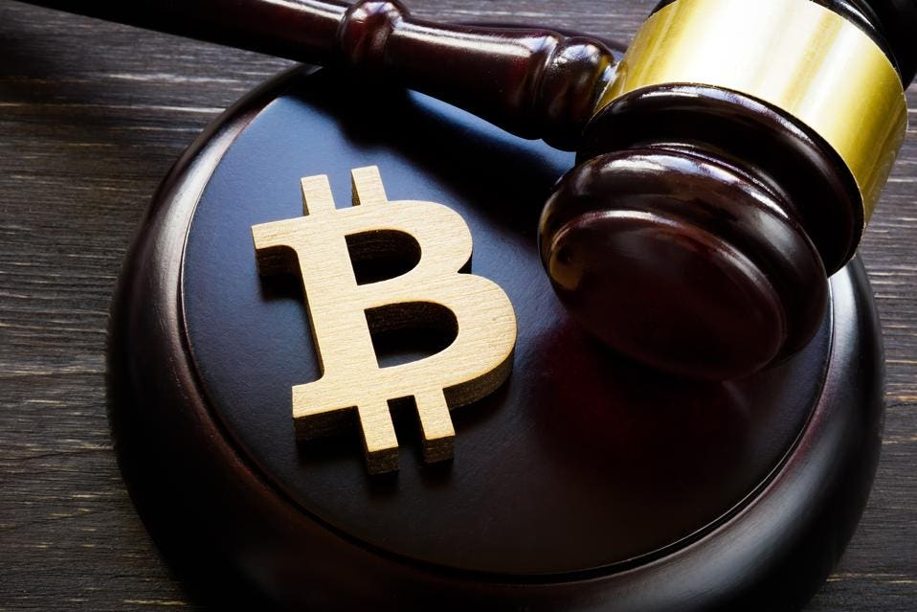
Challenges of Blockchain
Regulation
Uncertainty around legal frameworks
Notes:
High-volume transactions refer to a large number of business processes or transactions that occur within a short period. Sensitive cases also include businesses that have to deal with a continuous flow of voluminous transactions that they deal with on a regular basis.

Slide 13

Challenges of Blockchain
Energy Consumption
High computational power required for mining
Notes:
The CBECI estimates that global electricity usage associated with Bitcoin mining ranged from 67 TWh to 240 TWh in 2023, with a point estimate of 120 TWh. The International Energy Agency estimated global consumption of electricity during 2023 to have been 27,400 TWh.

Slide 14
Challenges of Blockchain
Security Concerns
Potential vulnerabilities in smart contracts
Notes:
Coding errors and bugs
Once deployed on the blockchain, smart contracts are immutable, so any flaws in the code can lead to significant vulnerabilities, including financial losses.
Reentrancy attacks
This vulnerability allows attackers to execute a function multiple times before the previous call completes, which can lead to unexpected and harmful behavior, such as the theft of funds or unauthorized access to data.
Integer overflow
This security vulnerability is usually inadvertently introduced by programmers and may cause some features of the contract to fail. In the most severe case, it may lead to hacker attacks and economic losses.
Access control
If not properly implemented, an attacker may gain access to sensitive data or even modify the contract for malicious purposes. This vulnerability can be exploited to steal funds or execute malicious code.
Front-running attacks
Recent studies have shown that front-running attacks are prevalent on the Ethereum blockchain and have caused millions of US dollars loss.

Slide 15
Challenges of Blockchain
Scalability
Regulation
Handling a large volume of transactions
Uncertainty around legal frameworks
Energy Consumption
Security Concerns
High computational power required for mining
Potential vulnerabilities in smart contracts
Notes:
Despite its potential, Blockchain faces certain challenges. Scalability is an issue as the network can become congested with high transaction volumes. Mining with high computational power can be energy-intensive. Regulatory frameworks surrounding cryptocurrencies and blockchain applications are still evolving. Additionally, security concerns exist, particularly regarding potential vulnerabilities in smart contracts.

Slide 16
The Future of Blockchain
Continued development and innovation
Potential to disrupt various industries

Slide 17

Thanks!
Do you have any questions?
Group -1
1 Habtamu Ayenew 1200/13
2 Abdulwekil Abrar 0060/13
3 Abel Fikere 0094/13
4 Daniel Tadesse 0693/13
5 Eyuel Abera 1198/13
6 Fuad Mustefa 1066/13
7 Genet Mengestu 1148/13
8 Kaleb debela 1441/13

